Slide 1

Automatic Attendance System
Using (ble)Beacon and android application

Slide 2
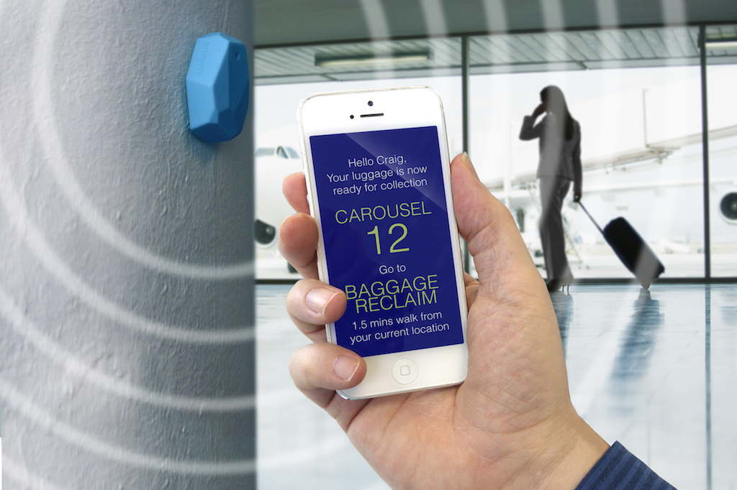

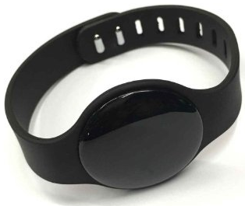
What We will Deliver
Android Application of Attendance System with SQL Server for attendance storage.
The App will search the range of Bluetooth device parameters of Beacon device.
Beacon is a Bluetooth Device which works on DC battery of life 2-3 years.
Beacon device could be in form of wrist bands and ID cards and in turn associated with peoples
This will change the manual swipe Attendance to Automatic Attendance.

Slide 3
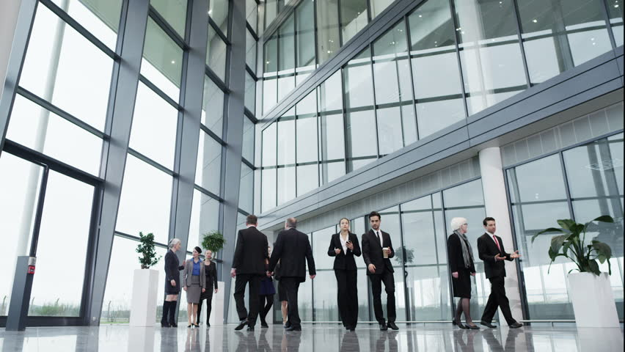
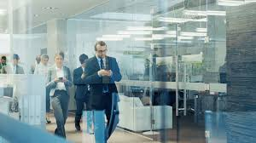
Scope of Project
Reduce paperwork and save time and money with mobile and cloud-based attendance management system.
Eliminate duplicate data entry and errors in time and attendance entries.
Real-time status tracking of leave requests.
Improve visibility to track and manage people attendance & absenteeism across multiple campuses.
Increased security and confidentiality with role-based permissions to users.
Auto-generate various types of reports of employee or student attendance.
Automatic attendance recording, reducing the effort of manual attendance.

Slide 4
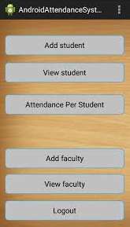
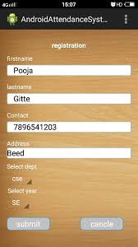
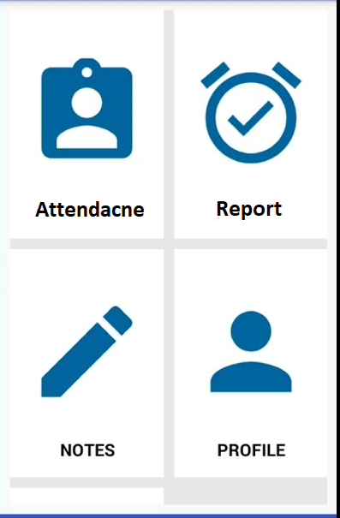
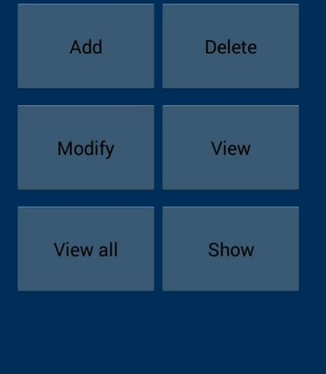
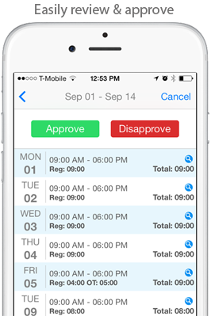
UI (User Interface)/UX(User Experience) of App

Slide 5
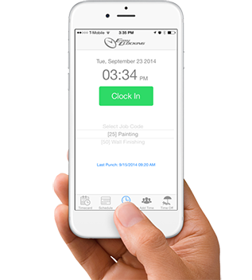
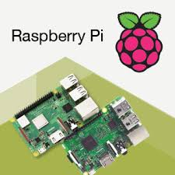

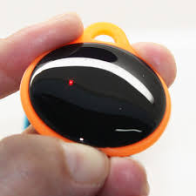
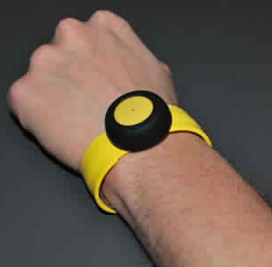
Functionality of Project
Attendance is Saving in SQL Server using “Web Service – Web API (Restful Service)”
Android OS Device
Ex: Mobile , Raspberry Pi
2-3 years life DC battery Bluetooth Beacon
Searching for BLE Beacon

Slide 6
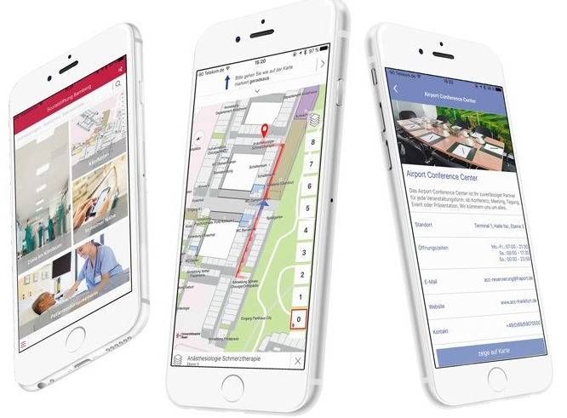
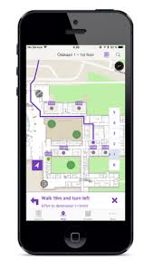
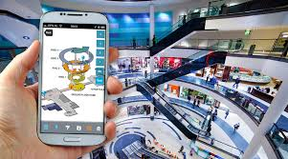
Future Development Scope
1. Indoor Navigation App Using BLE Beacon .
This system is used when there is low range of GPS Device. Ex: Mountainous Region and internal buildings.
GPS does not work at minor precise range i.e. inside the buildings, it is only for top pointing location.
For that purpose Beacon is installed at desired locations and through them longitudes & latitudes are fetched and displayed on maps, giving full precise UI/UX navigation

Slide 7
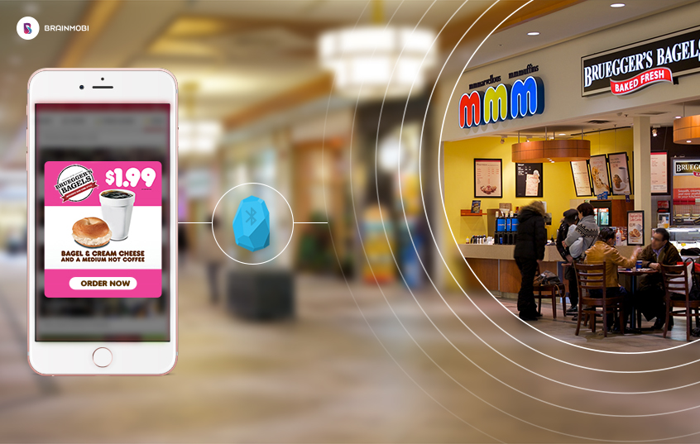
Future Development Scope
2. Internal Information of Valuables and things.
This system is used in malls , restaurants, museums, etc. to give full information of valuables/things.
Beacon is installed at the valuables and as soon as the person comes near it , the beacon is detected by the persons mobile and the informational data is pushed from the server to the mobile device.
Ex: A person visiting a museum comes nearby a painting all the information is fetched from the server to the mobile about, how old is the painting, who have made it ,etc.

Slide 8
Our Current Completed Work
Sketch Design of UI/UX completed.
Architecture of the system completed.
Work and Data flow of the system completed.
Database and web service (backend) making is started.
Front end Mobile Android app is started.
Software Resources Used
Android Studio.
Visual Studio 2015 (MVC and Web API).
Microsoft SQL Server 2017.

Slide 9
Our Team - Vivekanand Education Society Institute of Technology
Mohammed Saad Shaikh (Team Lead) .
Parvez Mullah .
Shaikh Maroof .
Twinkle Shamnani .

Slide 10
Thank you

